Slide 1
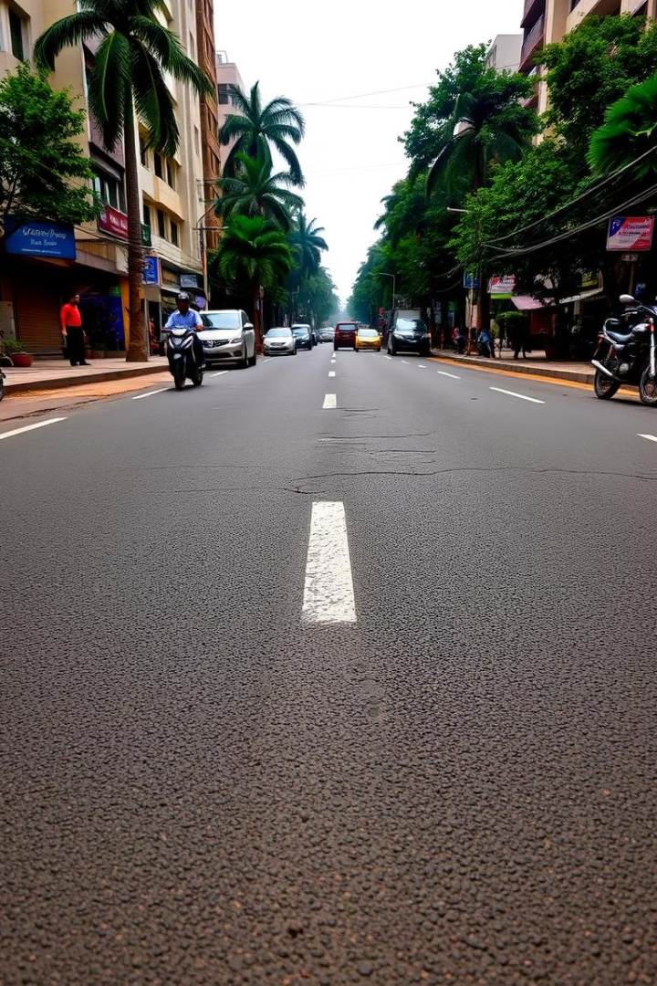
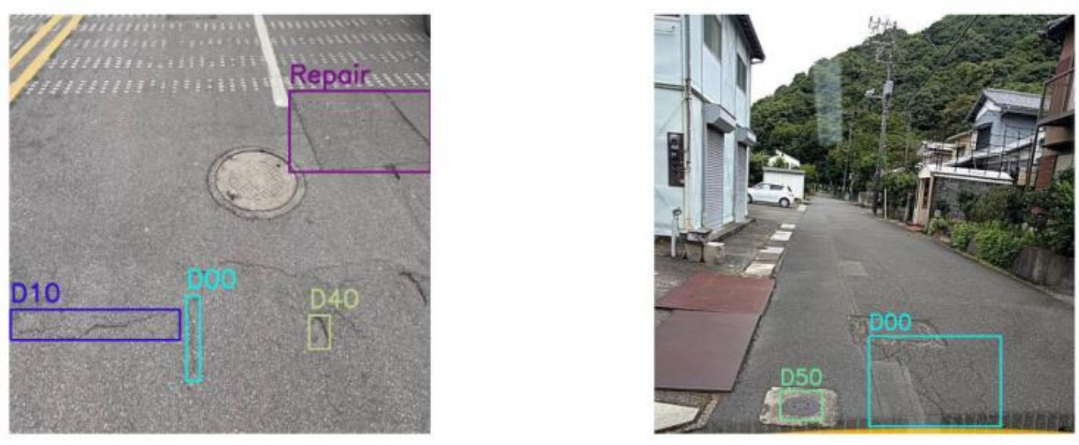
Vision-Based Road Damage Detection and Assessment in Indian Context
Presented by Pratyaksh & Shalini
from Lovely Professional University ,
guided by Kirti Mam.

Slide 2
Introduction to India's Road Network Challenges
India has the world's second-largest road network.
Manual road inspection is slow and inconsistent.
Over 40% of roads suffer damage due to poor maintenance and harsh climate.
AI-based solutions offer efficient damage detection and classification.

Slide 3
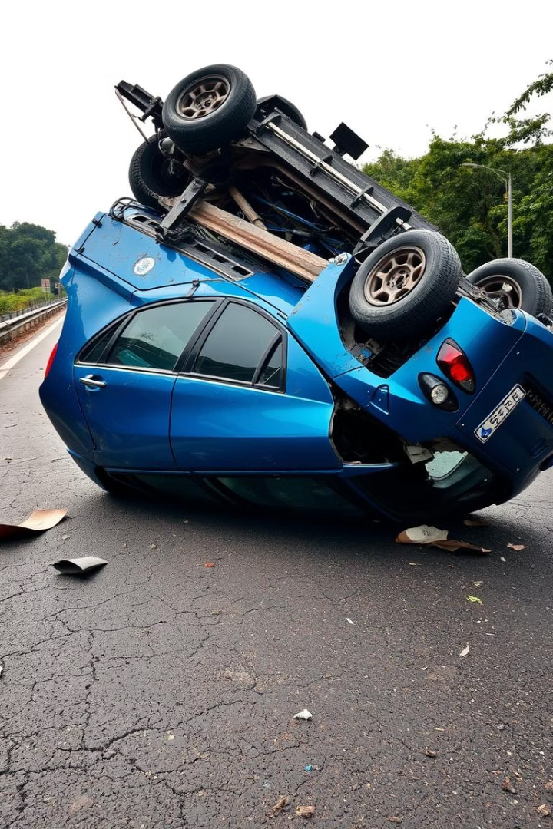
Problem Statement
Increasing Road Damage
Limitations of Manual Methods
Rising accidents linked to poor road conditions in India.
Not scalable or capable of real-time monitoring.
Need for Automation
Requires accurate, scalable, and automated detection solutions.

Slide 4
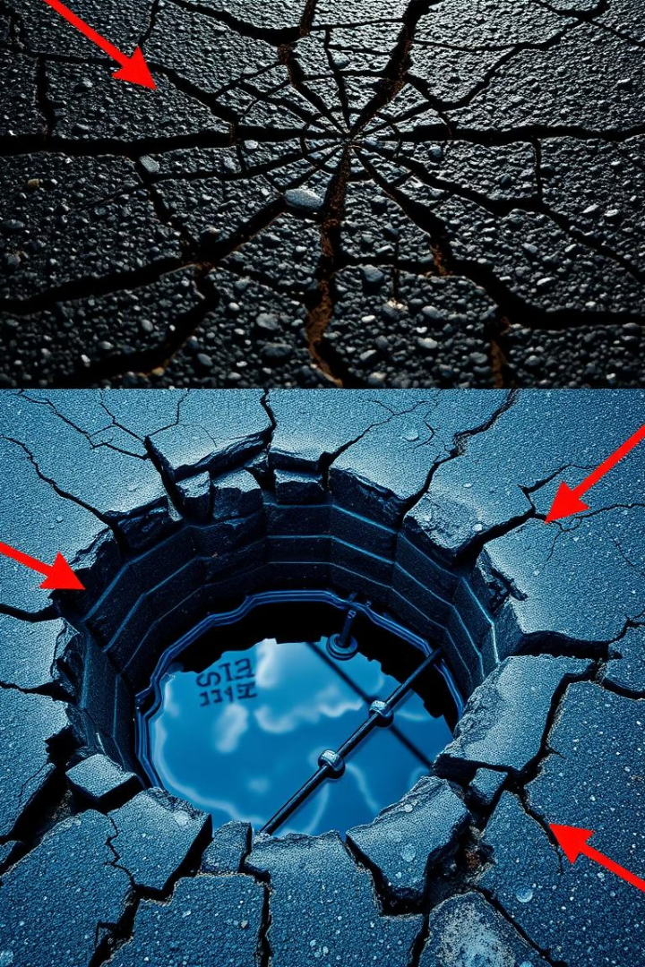



Research Objectives
Damage Detection
Damage Classification
Indian Road Adaptation
Employ deep learning to detect road damages via image analysis.
Alligator Crack
Adapt models for diverse and challenging road conditions in India.
Lateral Crack
Longitudinal Crack
Pothole

Slide 5
Dataset & Preprocessing Techniques
Image Sourcing
Data Conversion & Cleaning
Collected from public Indian datasets and simulations.
Transformed Pascal VOC format to YOLO format.
Removed noisy data and irrelevant classes for accuracy.
Preprocessing includes resizing, normalization, and cropping.

Slide 6
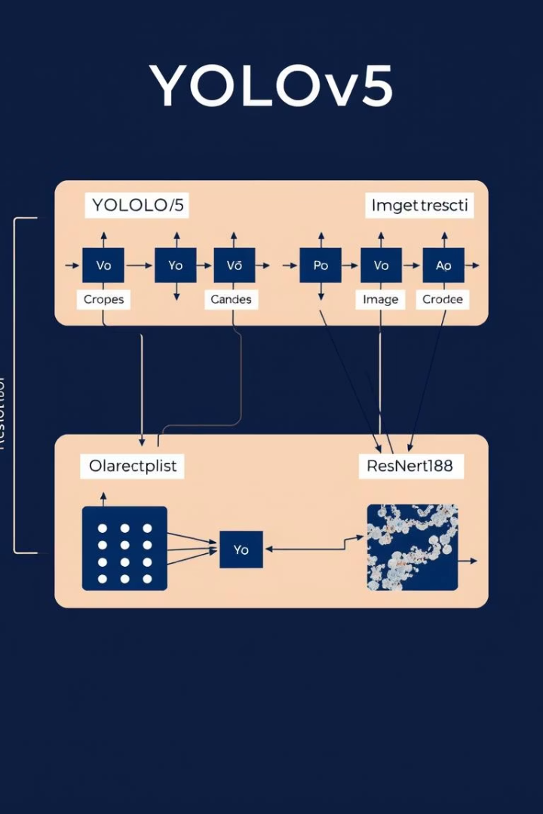
Model Architecture & Implementation
Model Components
Processing Pipeline
Utilizes YOLOv5 and ResNet18 for efficient CNN-based detection.
Input images undergo preprocessing before CNN output labels damages.
Real-time Capability
Optimized for quick inference compatible with video processing.

Slide 7
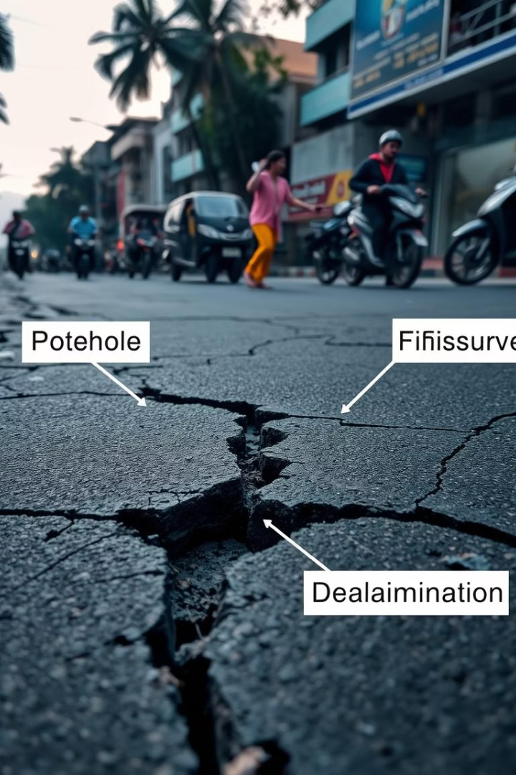



Results, Analysis & Demo Output
Accuracy
Achieved approximately 85% detection accuracy in simulations.
Balanced Detection
Confusion matrix shows even detection across all damage types.
Demo Highlights
Video snippets showcase real-time classification and damage type distribution.

Slide 8
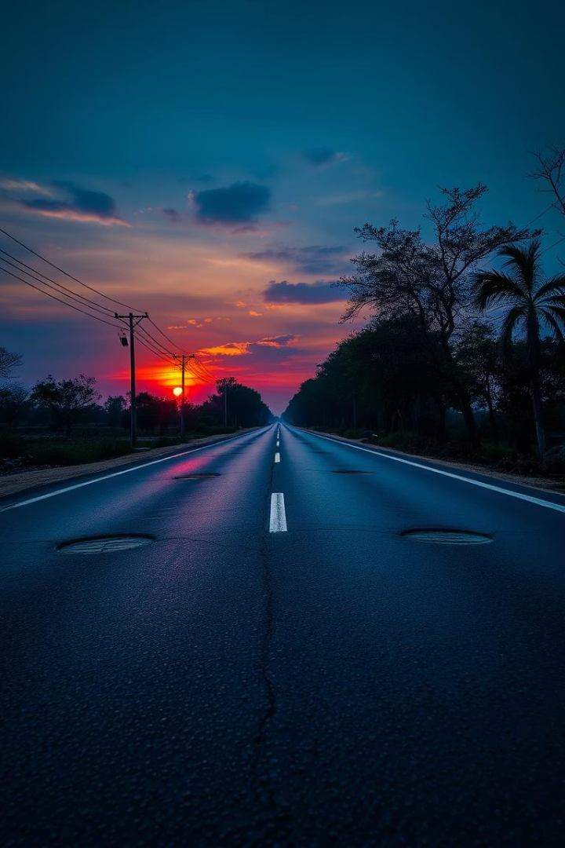
Challenges in Indian Road Damage Detection
Variable Conditions
Different road surfaces and lighting complicate detection accuracy.
Limited Datasets
Scarcity of well-annotated Indian road damage datasets is a barrier.
Data Format Complexity
Converting between annotation formats presents technical challenges.

Slide 9
Conclusion & Future Directions
Conclusion
Future Scope
System effectively detects damages, adaptable to Indian roads.
GPS tagging for precise damage localization
Drone surveys for extensive road monitoring
Supports scalable, real-time monitoring aiding Smart City planning.
Partnerships with government for nationwide implementation

